Slide 1
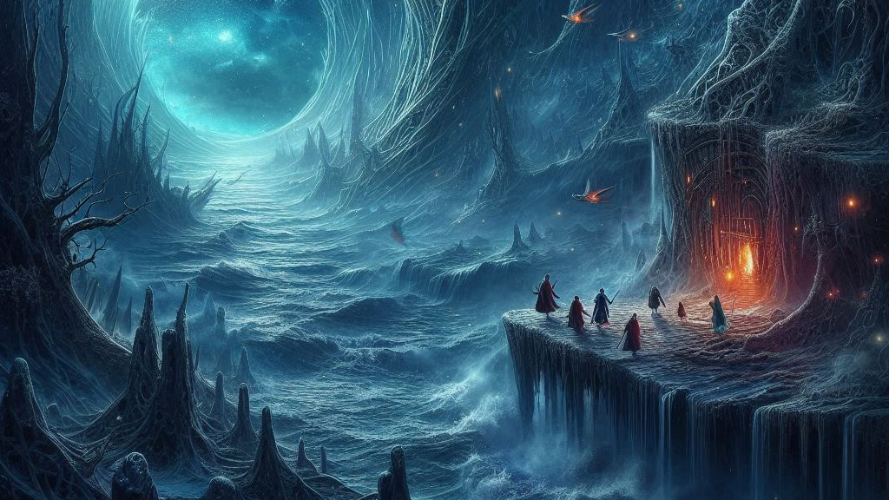
Deep Learning Networks
Notes:
Deep dark in middle earth the deep learning networks are flourishing

Slide 2
Where does Deep learning Fit?
Deep Learning
Deep learning is a specialized subset of machine learning that employs artificial neural networks with multiple layers to model and understand complex patterns in data.
This approach enables systems to learn from vast amounts of unstructured data, such as images, audio, and text, by processing information through hierarchical layers that extract increasingly abstract features.
Key Ideas: Convolutional Neural Networks, Recurrent NN, LSTM, GAN, Transformer Networks.
Artificial Intelligence
Data Science
Visualization
Data Analysis
Machine Learning
Streaming
Data
Statistics
Deep Learning
Large-Scale
Data Collection
Generative AI
DBMS
Data Engineering

Slide 3

Deep Neural Network Architecture
DNNs are structured into layers:
Input Layer: Takes the features of the data.
Hidden Layers: Learn complex patterns. (Two or many more)
Output Layer: Produces the final predictions.
Deep Neural Networks are technically defined as any network with more than one hidden layer.
But in practice, they usually have many hidden layers.

Slide 4
Different Types of Deep neural Networks
Model | Primary Use | Key Idea | Typical Applications
CNN | Image data | Convolutions extract spatial features | Image classification, detection
RNN | Sequential data | Cyclic connections for temporal patterns | Time series, speech
LSTM | Sequential data | Memory + gating for long dependencies | Translation, speech synthesis
Transformer | NLP, vision, speech | Self-attention, parallelizable | Language models, ViTs
U-Net | Medical/segmentation | Encoder–decoder + skip connections | Biomedical segmentation
GANs | Image/video generation | Generator vs. discriminator | Image synthesis, style transfer
Vision Transformer (ViT) | Vision tasks | Patch embeddings + transformer blocks | Image classification, segmentation

Slide 5
Different Types of Deep neural Networks
Deep Neural Network | Primary Use Case | Key Features | Applications
Convolutional Neural Network (CNN). AlexNet, VGGNet, ResNet | Image Classification | Many layers, ReLU activation, dropout for regularization, trained on GPUs | Image recognition, feature extraction for transfer learning, object detection,
RNN (Recurrent Neural Network) | Sequential Data | Cyclic connections, ability to model sequential dependencies | Time-series analysis, speech recognition, machine translation
LSTM (Long Short-Term Memory) | Sequential Data | Memory cells, forget gates to handle long-term dependencies | Speech synthesis, natural language processing
Transformer | NLP, Vision, Speech | Self-attention mechanism, parallel processing, scalability | Language models (e.g., GPT, BERT), vision transformers
U-Net | Medical Imaging, Segmentation | Encoder-decoder architecture, skip connections for localization | Biomedical image segmentation
GANs (Generative Adversarial Networks) | Image/Video Synthesis | Adversarial training with generator and discriminator | Image synthesis, style transfer, data augmentation
Vision Transformers (ViT) | Image Processing | Transformer architecture for vision tasks, patch embeddings | Image classification, object detection, segmentation

Slide 6
Convolutional Neural Networks
A convolutional neural network, or CNN for short, is a type of classifier, which excels at image analysis
CNNs can be used for many different computer vision tasks, such as image processing, classification, segmentation, and object detection.
CNNs consist of different types of neural layers and operations:
Input Layer: Represents the input image into the CNN
Convolutional Layers: Contain the learned kernels (weights), which extract features that distinguish different images from one another
Activation Function: Applies much-needed non-linearity into the model. Non-linearity is necessary to produce non-linear decision boundaries
Pooling Layers: Gradually decreases the spatial extent of the network, which reduces the parameters and overall computation of the network
Flatten Layer: Converts a three-dimensional layer into a one-dimensional fully-connected layer for classification
Output Layer: Represents the class probabilities given the current inputs

Slide 7

Convolution Operation
During the forward pass, the kernel slides across the height and width of the image-producing the image representation of that receptive region.
This produces a two-dimensional representation of the image known as an activation map that gives the response of the kernel at each spatial position of the image.
The sliding size of the kernel is called a stride.
Notes:
https://towardsdatascience.com/convolutional-neural-networks-explained-9cc5188c4939

Slide 8
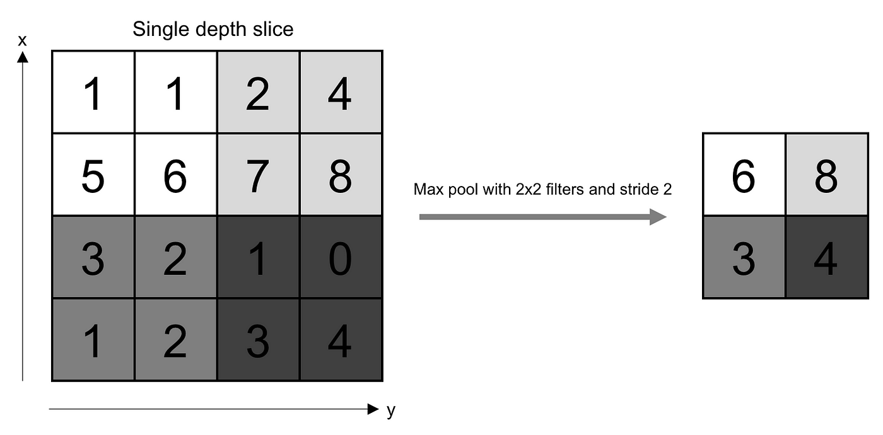
Pooling Operation
The pooling layer replaces the output of the network at certain locations by deriving a summary statistic of the nearby outputs.
This helps in reducing the spatial size of the representation, which decreases the required amount of computation and weights.

Slide 9
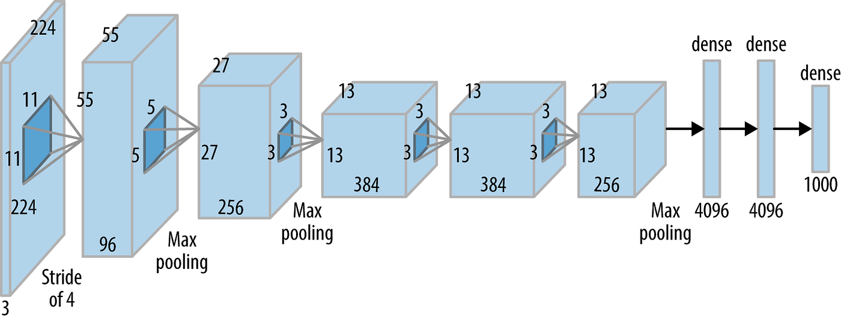
AlexNet (2012): Pioneering Deep Convolutional Networks
Notes:
AlexNet represents one of the pioneering applications of deep convolutional networks that truly reshaped the field of machine learning. In 2012, this revolutionary model clinched the top spot at the ImageNet LSVRC-2012 challenge by demonstrating a remarkable accuracy of 84.7%, far surpassing the second-best contender which achieved an accuracy of 73.8%.
The heart of AlexNet is its architecture, comprising five Convolutional (CONV) layers and three Fully Connected (FC) layers. AlexNet opts for the Rectified Linear Unit (ReLU) as its activation function, a strategic move that has contributed significantly to its impressive performance.

Slide 10
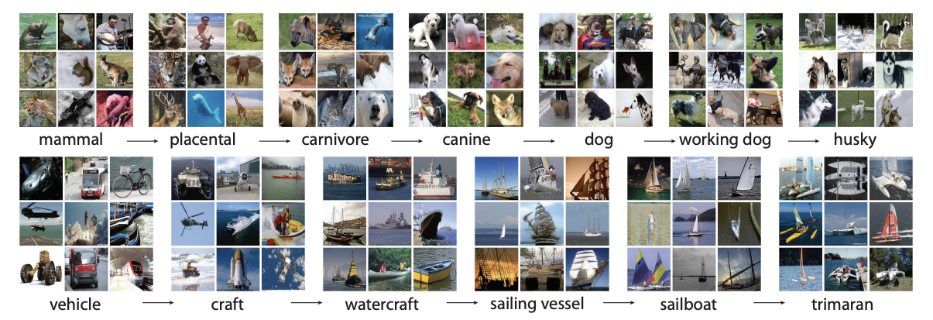
Imagenet
The database contains over 14 million labeled images.
A subset of ImageNet is used for the annual ILSVRC, a competitive benchmark for image classification, object detection, and localization tasks.
ImageNet was instrumental in the success of deep learning. In particular, the 2012 ILSVRC was a turning point when the AlexNet model (a deep CNN) dramatically outperformed traditional machine learning methods, showcasing the power of neural networks.
Notes:
The ImageNet database is a large-scale image dataset widely used in computer vision and machine learning research. It is designed to support the development and benchmarking of object recognition algorithms. ImageNet played a significant role in the evolution of deep learning, particularly in advancing convolutional neural networks (CNNs).
Key Features of ImageNet:
1. Hierarchical Structure:
• ImageNet is organized according to the WordNet hierarchy, a lexical database of English words grouped into sets of synonyms called “synsets.”
• Each synset represents a distinct concept, such as “dog” or “car,” and ImageNet contains images for tens of thousands of these synsets.
2. Large Scale:
• The database contains over 14 million labeled images.
• On average, each synset is associated with hundreds or thousands of images.
3. Labeling:
• Images are annotated with detailed labels corresponding to the synsets.
• The labels are verified for accuracy through crowd-sourcing platforms like Amazon Mechanical Turk.
4. Variety of Categories:
• The dataset includes diverse categories such as animals, objects, scenes, and tools, making it suitable for various types of visual recognition tasks.
5. ImageNet Large Scale Visual Recognition Challenge (ILSVRC):
• A subset of ImageNet is used for the annual ILSVRC, a competitive benchmark for image classification, object detection, and localization tasks.
• The ILSVRC dataset includes 1,000 object categories and approximately 1.2 million training images, making it a standard benchmark for deep learning models.
6. Impact on Deep Learning:
• ImageNet was instrumental in the success of deep learning. In particular, the 2012 ILSVRC was a turning point when the AlexNet model (a deep CNN) dramatically outperformed traditional machine learning methods, showcasing the power of neural networks.
Applications:
• Pretraining Deep Learning Models: Models trained on ImageNet are often used as a foundation (via transfer learning) for other tasks, as they provide robust feature representations.
• Object Recognition Research: It serves as a testbed for developing and evaluating computer vision algorithms.
• Benchmark for Model Comparisons: ImageNet is a widely used standard for comparing the performance of different computer vision models.
Limitations:
• Bias: Images in ImageNet may contain cultural and demographic biases.
• Static Nature: It does not account for temporal changes or dynamic scenarios.
• Restricted Use: Due to copyright and ethical concerns, access to the full dataset requires special permissions.
ImageNet continues to be a cornerstone in computer vision, inspiring innovations and benchmarking progress in the field.

Slide 11
The race for image recognition supremacy
Network | Year | Salient Feature | Top-5 Accuracy | Params | FLOPs
AlexNet | 2012 | First deep CNN breakthrough | 84.7% | 62M | 1.5B
VGGNet | 2014 | Deep with fixed 3×3 kernels | 92.3% | 138M | 19.6B
Inception (GoogLeNet) | 2014 | Parallel “wider” kernels | 93.3% | 6.4M | 2B
ResNet-152 | 2015 | Residual/skip connections | 95.5% | 60.3M | 11B
DenseNet-201 | 2016 | Dense connectivity (feature reuse) | 95.8% | 20M | ~4B
MobileNetV2 | 2018 | Depthwise separable convs | ~90% | 3.4M | 300M
EfficientNet-B7 | 2019 | Compound scaling (depth/width/res) | 97.1% | 66M | 37B
ConvNeXt-L | 2022 | ConvNet redesigned for transformer-level performance | ~87% top-1 | 198M | ~4B
AlexNet vs. ResNet-152: Both have ~60M parameters, but ResNet-152 delivers ~10% higher top-5 accuracy and needs much more computation, increasing training cost.
VGGNet: Far more parameters and FLOPs than ResNet-152 but with lower accuracy, making it slower and less efficient.
Training Cost: AlexNet and ResNet-152 train in similar time, but ResNet-152 uses ~10× less memory and achieves ~9% better accuracy.
EfficientNet: Uses compound scaling to achieve state-of-the-art accuracy with fewer FLOPs—much more efficient than VGG/ResNet fsor similar performance.
ConvNeXt: A modernized ConvNet offering transformer-level accuracy while keeping CNN-style efficiency and simpler training.

Slide 12
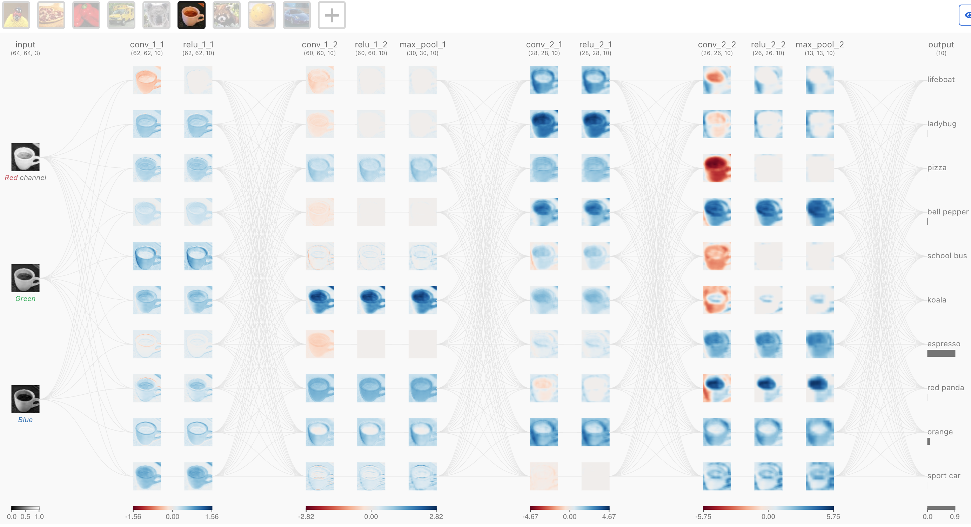
CNN Explainer: Interactive Experimentation
https://poloclub.github.io/cnn-explainer/
Notes:
Introduction to the interface: https://www.youtube.com/watch?v=HnWIHWFbuUQ

Slide 13
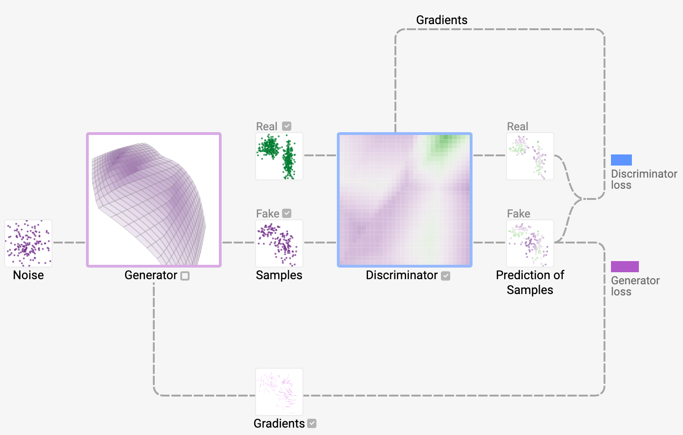
Generative Adversarial Networks (GAN)
Generative Adversarial Networks (GANs) are a type of deep learning model introduced by Ian Goodfellow and colleagues in 2014.
GANs are primarily used in generative modeling, where the goal is to generate data similar to a given dataset, such as synthesizing realistic images, generating music, or creating text. (Wikipedia, MathWorks).
GANs consist of two neural networks:
Generator: Generates synthetic data that resembles the real data distribution.
Discriminator: Attempts to distinguish between real data and data generated by the generator.
These networks are trained simultaneously through a process called adversarial training. The generator improves by trying to "fool" the discriminator, while the discriminator enhances its ability to correctly classify real and synthetic data (IBM).
Training Process:
The generator starts by producing random outputs. Over time, it adjusts its weights to create data closer to the real samples.
The discriminator evaluates whether inputs are real or fake and provides feedback to the generator.
Both networks use feedback to improve: the generator learns to create better data, and the discriminator becomes more skilled at identifying fakes.
The objective is for the generator to produce outputs so realistic that the discriminator cannot distinguish between real and synthetic data with high confidence (Coursera).

Slide 14
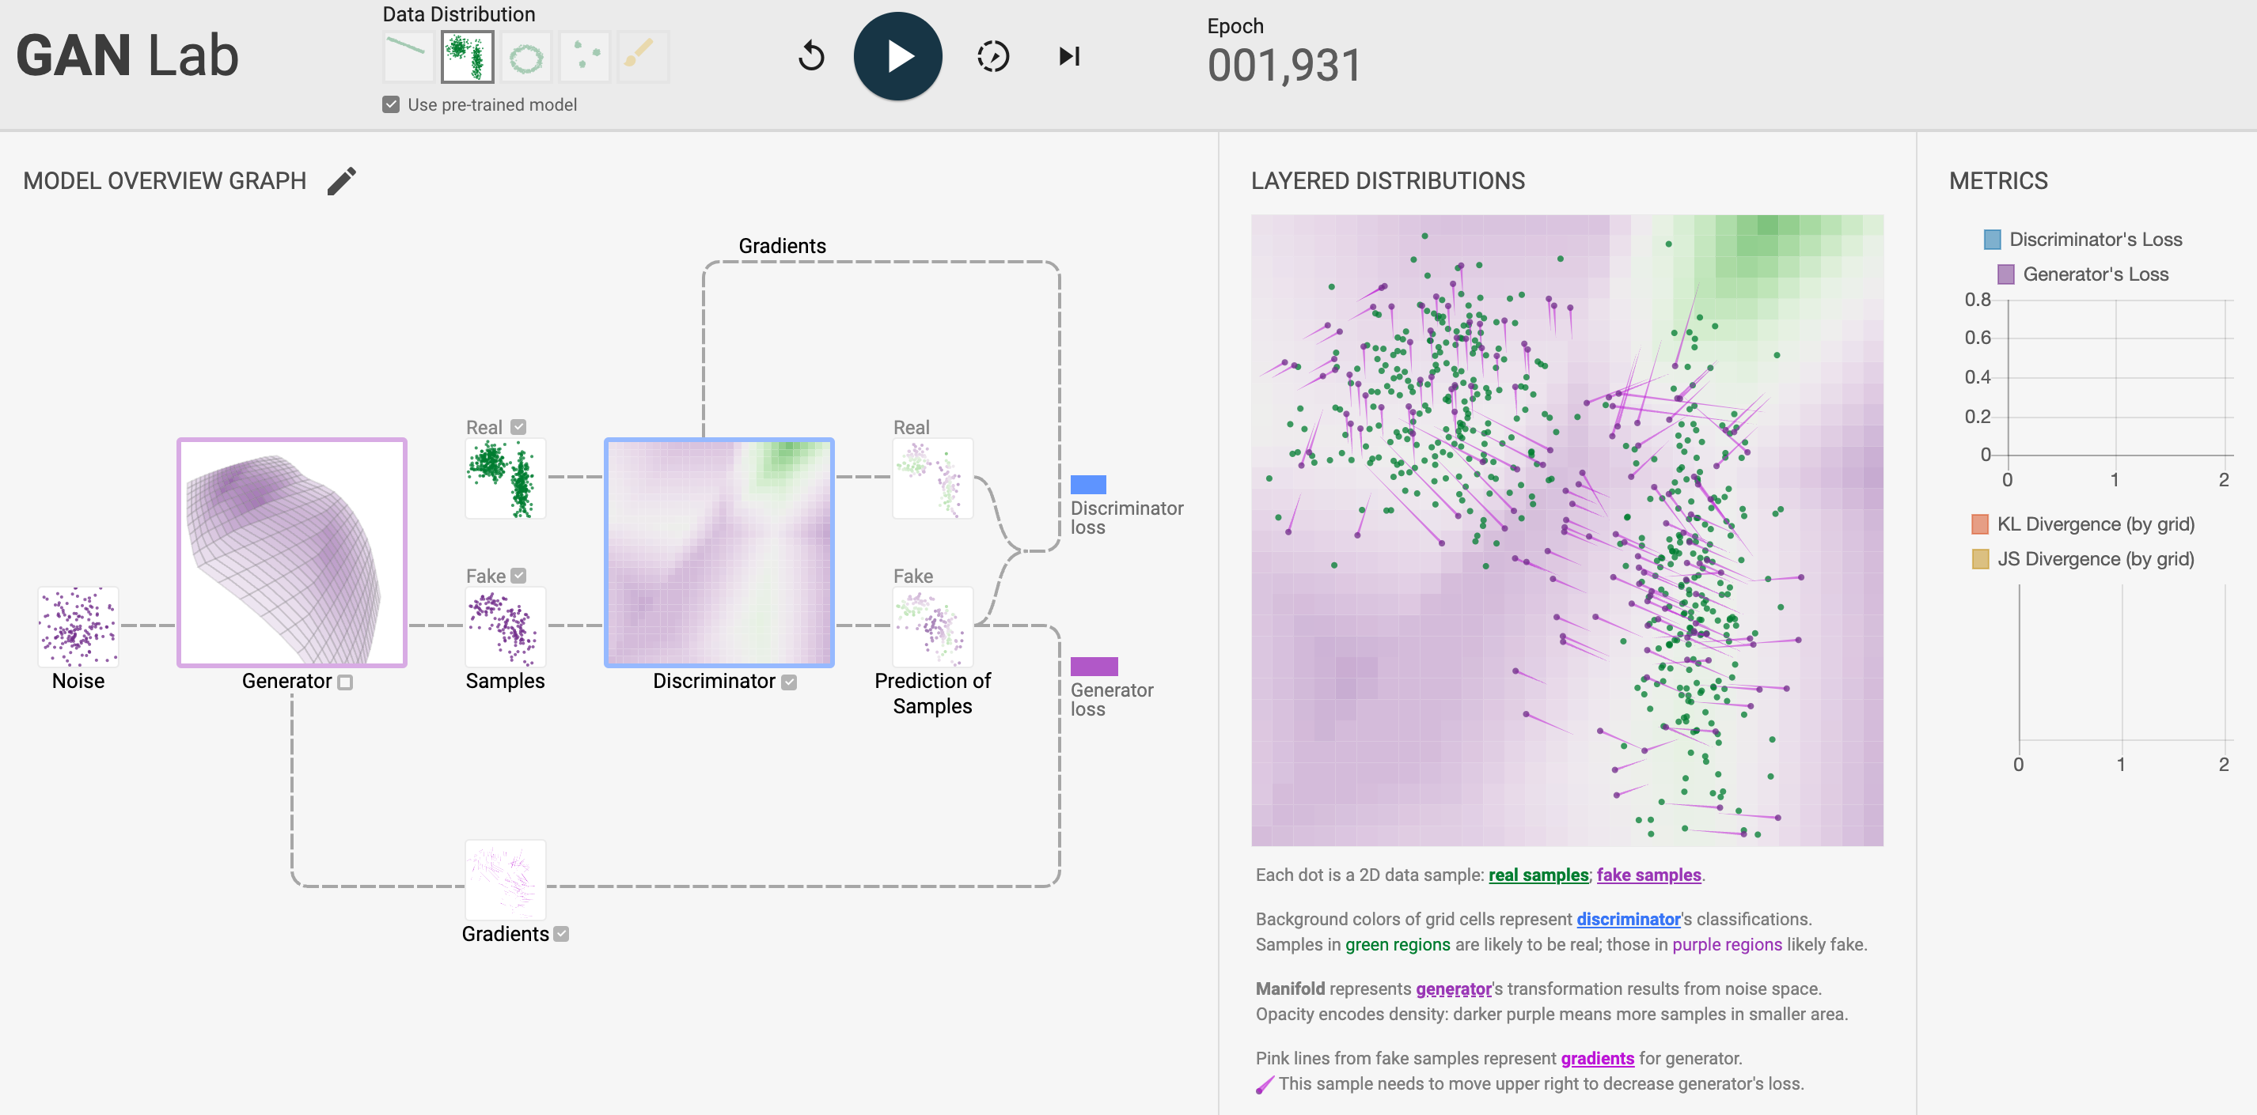
https://poloclub.github.io/ganlab/

Slide 15
Transformer Networks
Fundamentally, text-generative Transformer models operate on the principle of next-word prediction: given a text prompt from the user, what is the most probable next word that will follow this input?
The core innovation and power of Transformers lie in their use of a self-attention mechanism, which allows them to process entire sequences and capture long-range dependencies more effectively than previous architectures.
Every text-generative Transformer consists of these three key components:
Embeddings — turning words into meaning
Text is split into tokens (words or subwords).
Each token becomes a vector called an embedding, placing words in a space where similar meanings are close together.
Transformer Blocks — the model’s “thinking steps”
Each block has two important pieces:
Self-Attention: Lets each token “pay attention” to other tokens to figure out which ones matter for understanding the current word.
Feed-Forward Network (MLP): A small neural network applied to each token individually, helping refine each token’s representation after it gathers context.
Output Layer — turning understanding into predictions
After several transformer blocks, the model uses a linear layer + softmax to convert the final token representation into a probability distribution over all possible next tokens.

Slide 16
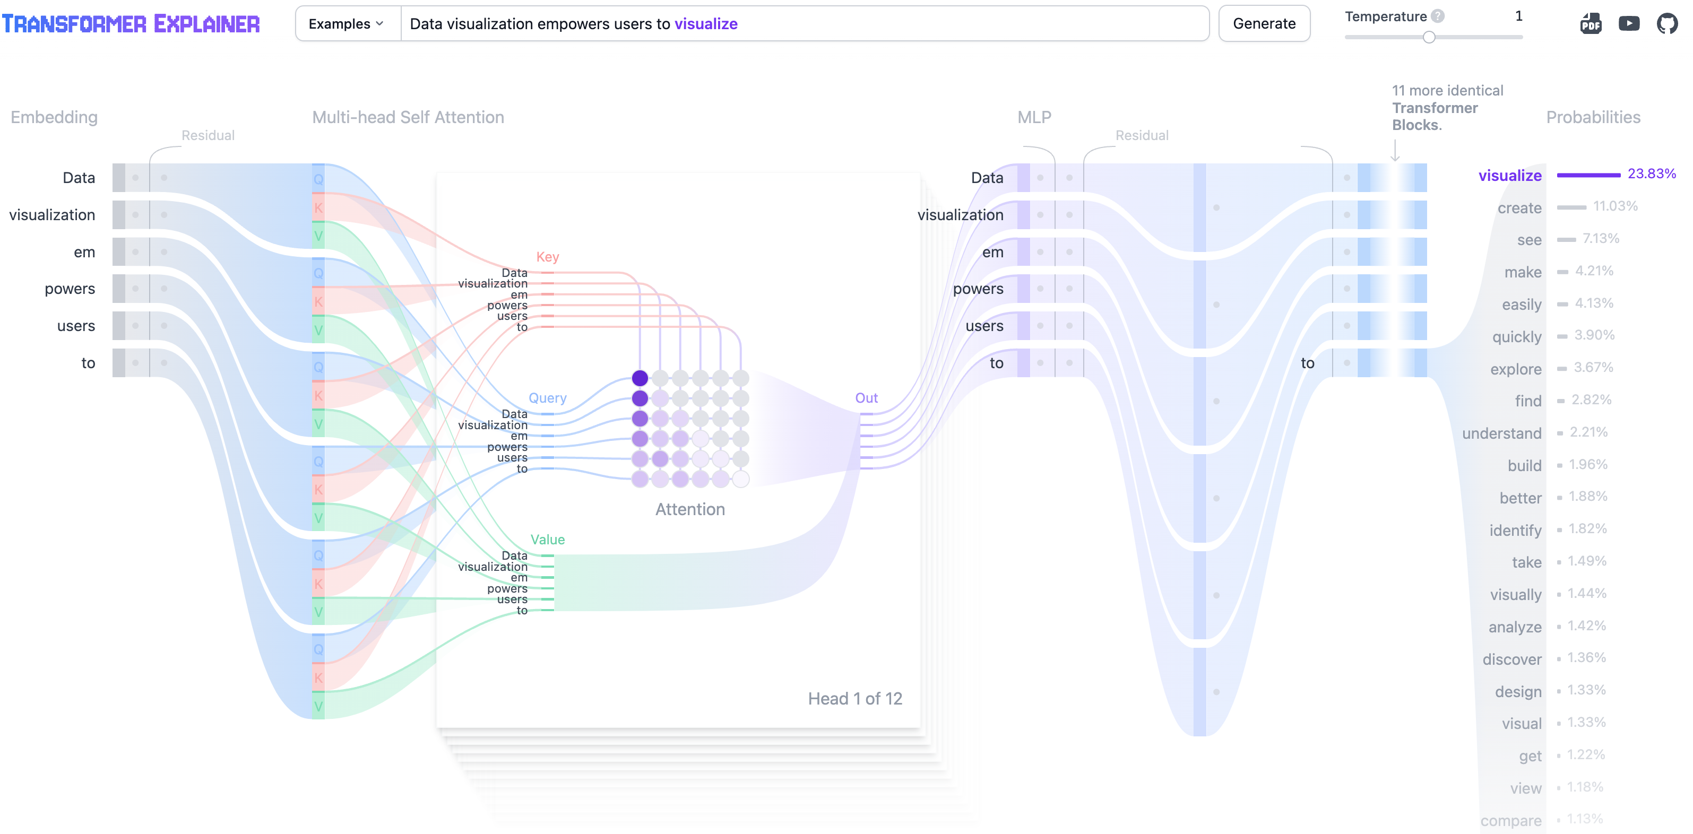
Transformer Explainer
https://poloclub.github.io/transformer-explainer/
Notes:
Overview of Transformer Explainer: https://www.youtube.com/watch?v=ECR4oAwocjs&t=22s
More details about the Explainer: https://www.youtube.com/watch?v=V5kAmFRwuxc
Paper: https://arxiv.org/pdf/2408.04619
Also see 3blue1brown LLM models explained briefly 0:41--07:45 https://www.youtube.com/watch?v=LPZh9BOjkQs&list=PLZHQObOWTQDNU6R1_67000Dx_ZCJB-3pi&index=5

Slide 17
LLM Visualization
Large Language Models for the curious beginner (3blue1brown) https://www.youtube.com/watch?v=LPZh9BOjkQs&list=PLZHQObOWTQDNU6R1_67000Dx_ZCJB-3pi&index=5

Slide 18
Stable Diffusion Networks
Stable Diffusion is a text-to-image model that generates high-resolution images from text prompts.
We break down the image generation process into three main steps:
Text Representation Generation: Stable Diffusion converts a text prompt into a text vector representation.
Image Representation Refining: Starting from random noise, Stable Diffusion refines the image representation gradually, guided by the text representation. Stable Diffusion repeats the refining over multiple timesteps (50 in our Diffusion Explainer).
Image Upscaling: Stable Diffusion upscales the image representation into a high-resolution image.

Slide 19
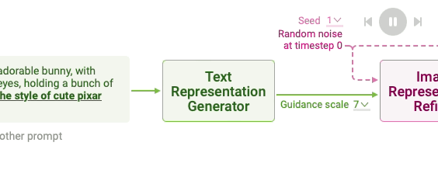
Text Representation (Tokenization and encoding)
Stable Diffusion tokenizes a text prompt into a sequence of tokens. For example, it splits the text prompt ”a cute and adorable bunny” into the tokens a, cute, and, adorable, and bunny.
Also, to mark the beginning and end of the prompt, Stable Diffusion adds <start> and <end> tokens at the beginning and the end of the tokens. The resulting token sequence for the above example would be <start>, a, cute, and, adorable, bunny, and <end>.
Text Encoding: To use the text representation for guiding image generation, Stable Diffusion ensures that the text representation contains the information related to the image depicted in the prompt. This is done by using a special neural network called CLIP.
CLIP, which consists of an image encoder and a text encoder, is trained to encode an image and its text description into vectors that are similar to each other. Therefore, the text representation for a prompt computed by CLIP’s text encoder is likely to contain information about the images described in the prompt.

Slide 20
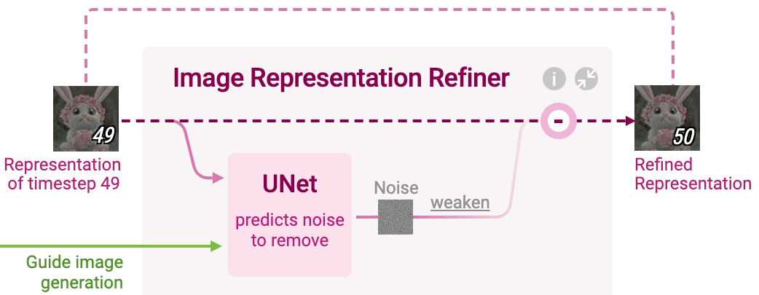
Image Refiner
Stable Diffusion generates a vector that numerically summarizes a high-resolution image depicted in the text prompt.
This is done by refining a randomly initialized noise over multiple timesteps to gradually improve the image quality and adherence to the prompt
At each timestep, a neural network called UNet predicts noise in the image representation of the current timestep.
UNet takes three inputs:
Image representation of the current timestep
Text representation of the prompt to guide what noise should be removed from the current image representation to generate an image adhering to the text prompt
Timestep to indicate the amount of noise remaining in the current image representation

Slide 21
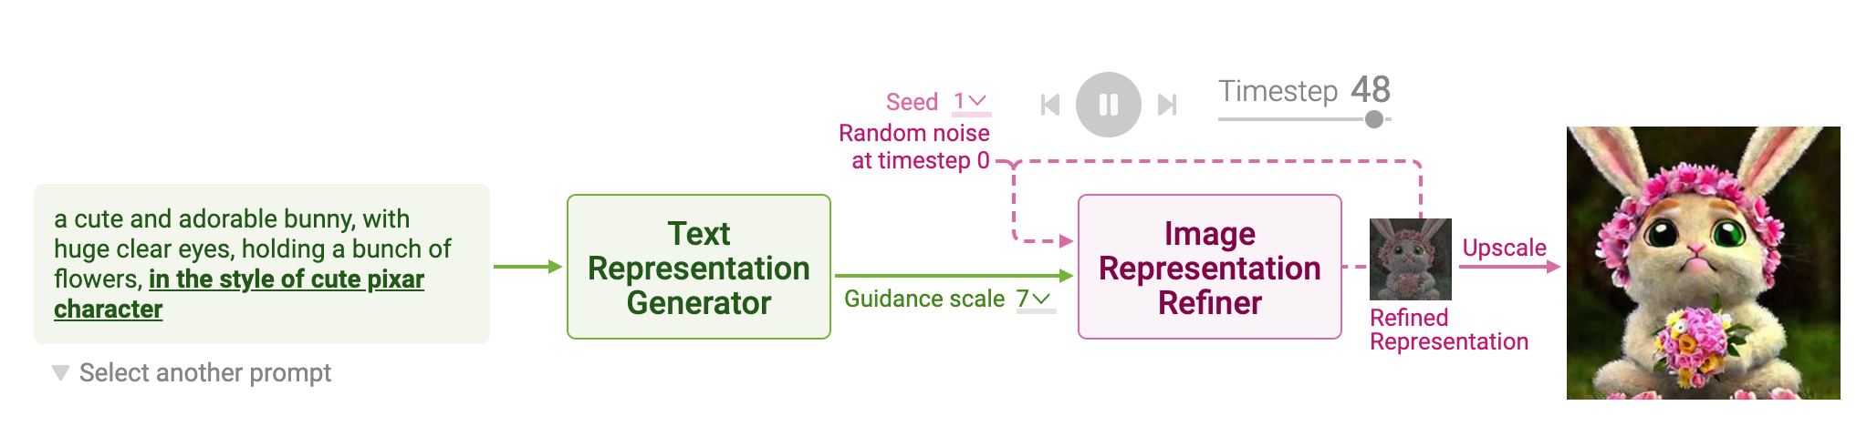
Stable Diffusion Explainer
https://poloclub.github.io/diffusion-explainer/

Slide 22
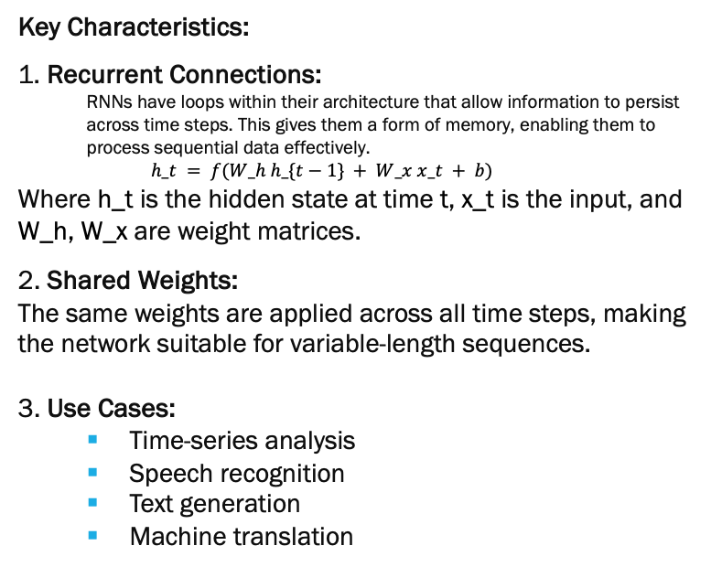
Recurrent Neural Networks (RNN)
RNNs are a class of neural networks designed for sequential data processing, where the order of inputs matters (e.g., time series, language, or audio).
RNN addresses the memory issue by giving a feedback mechanism that looks back to the previous output and serves as a kind of memory.
Since the previous outputs gained during training leaves a footprint, it is very easy for the model to predict the future tokens (outputs) with help of previous ones.
Problems with RNN :
Exploding and vanishing gradient problems during backpropagation.
Gradients are those values which to update neural networks weights. In other words, we can say that Gradient carries information.
Vanishing gradient is a big problem in deep neural networks. it vanishes or explodes quickly in earlier layers, and this makes RNN unable to hold information of longer sequence and thus RNN becomes short-term memory.
Key Characteristics:
1. Recurrent Connections:
RNNs have loops within their architecture that allow information to persist across time steps. This gives them a form of memory, enabling them to process sequential data effectively.
$$h_t = f(W_h h_\{t−1\} + W_x x_t + b)$$
Where h_t is the hidden state at time t, x_t is the input, and W_h, W_x are weight matrices.
2. Shared Weights:
The same weights are applied across all time steps, making the network suitable for variable-length sequences.
3. Use Cases:
Time-series analysis
Speech recognition
Text generation
Machine translation

Slide 23
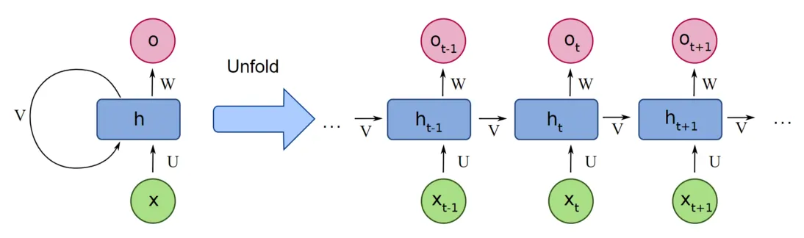
Recurrent Neural Network Architecture
https://www.analyticsvidhya.com/blog/2022/03/a-brief-overview-of-recurrent-neural-networks-rnn/

Slide 24
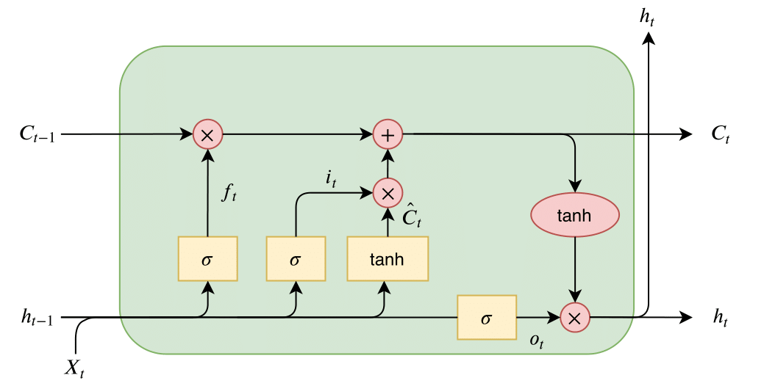
Long Short term Memory (LSTM) Networks
LSTMs are a type of RNN that addresses the vanishing gradient problem, enabling the capture of long-term dependencies in data. They achieve this through a gating mechanism that regulates information flow.
Key Components:
Forget Gate: Decides what information to discard.
Input Gate: Determines which new information to store.
Output Gate: Controls the output based on internal states.

Slide 25
Summary
Backpropagation of Errors (Backprop) is a core algorithm for almost all deep learning networks. Therefore, understanding and mastery of this algorithm will be essential for understanding other deep learning networks
Deep Networks often have many hidden layers. One example is Convolutional Neural Networks.
CNNs are the most popular approach for image understanding. There are many different types of CNNs that have continuously improved image classification performance on the ImageNet database.
Generative Adversarial Networks (GANs) are used in generating synthetic image, audio, text data. The main idea is the use of competing Generator and Discriminator networks.
Transformer networks are at the heart of every Large Language model today. They combine the ideas of data embedding (text, image, audio, etc.) with conventional MLPs and Attention blocks with Softmax output that can be interpreted as the probability of the next token. Token probabilities can be modified by scaling the Softmax function using a “temperature” parameter.
There are many other types of deep learning networks, such as Recurrent Neural Networks (RNNs), Long Short-Term Memory (LSTM) networks, and others.
We are in a “golden age” of artificial intelligence driven by advances in deep learning networks. There is much more to be discovered, and many more advances are anticipated that will drive increasing application opportunities.

Slide 26
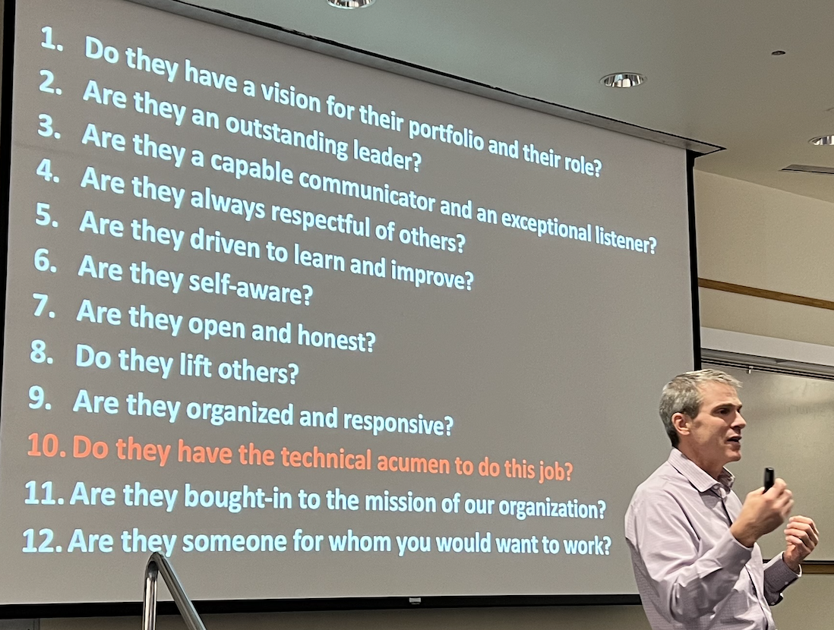
Technical Knowledge is only one Part of your preparation
Peter Whiting, LDS Church CTO, Dec 5, 2024, Graduate Seminar.
List of key attributes in priority order for new hires.

Slide 27
References
3blue1brown Transformer Networks: https://www.youtube.com/watch?v=wjZofJX0v4M&list=PLZHQObOWTQDNU6R1_67000Dx_ZCJB-3pi&index=6
https://medium.com/@prathammodi001/convolutional-neural-networks-for-dummies-a-step-by-step-cnn-tutorial-e68f464d608f
Convolutional Neural Networks: A Comprehensive Guide: https://medium.com/thedeephub/convolutional-neural-networks-a-comprehensive-guide-5cc0b5eae175

